Slide 1
Scripted Model Development
Jake Knight
Hydrologist
USGS Arizona Water Science Center

Slide 2
Introductions
Who am I?
Who are you?
Agenda
2 – 3 short presentations on how/why to use Python code for model development
Live demonstrations between each presentation
Instructions for downloading the software and code presented today
Tips for getting started, links to helpful resources
Anything else you want to discuss

Slide 3

All about me (20yrs ago)
Miami Undergrad 2001-2005
Political science
Pre-med
Electives!
Geology seminar, German 101, Jazz orchestra
Somehow led to:
MUDEC study abroad semester in Luxemburg
Europe and the Environment, taught by….
Which led to:
HYDROLOGY!

Slide 4



All about me (20yrs ago)
Environmental Science! HYDROLOGY!

Slide 5




Slide 7
All about YOU
What’s your major, minor, thesis topic?
Any interest in Environmental System modeling?
Any experience writing/using code?
Care to share something about yourself?

Slide 8
Agenda - Water we doing here
Interactive(ish) presentations that you can download and use later on
Ideally, we would install the software on your machines and run the code together, but too many IT pitfalls for 2 hr remote session
Scripts are recipes, start simple and build from there
Introduction to scripted-development model workflows
Python + FloPy for MODFLOW models
Load, build, run, investigate, plot
Python + PyEmu for PEST++ deployments
Define parameters and observations, evaluate and upgrade ensembles of models
Case study on opportunities and benefits of a scripted approach
Anything else you want to discuss!
Career advice? Let me tell you about USGS!

Slide 9
Presentation 1: MODFLOW + Python = FLoPy

Slide 10
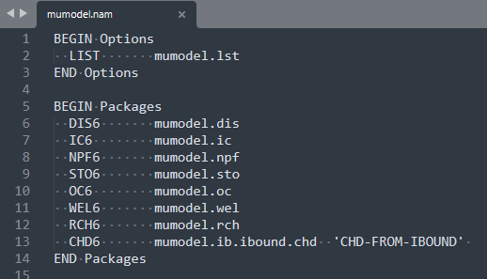
MODFLOW + Python = FLoPy model input
MODFLOW input is a collection of simple text files
NAM file specifies the packages to be used and points to the (other) text files containing the input for those packages

Slide 11
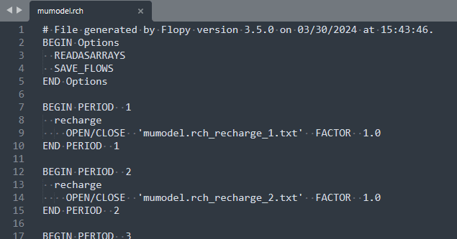
MODFLOW + Python = FLoPy model input
MODFLOW input is a collection of simple text files
Each package is defined by options and properties in its own specific text file

Slide 12
MODFLOW + Python = FLoPy model input
MODFLOW input is a collection of simple text files
The properties for a given package can be defined as values within the package file, or in separate external files that are pointed to by the package file

Slide 13
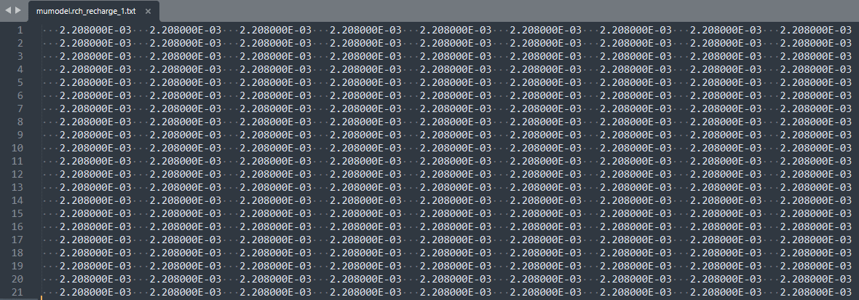
MODFLOW + Python = FLoPy model input
MODFLOW input is a collection of simple text files
Properties are defined as arrays or lists. In this case our model has a recharge rate defined for each model cell in the first stress period

Slide 14
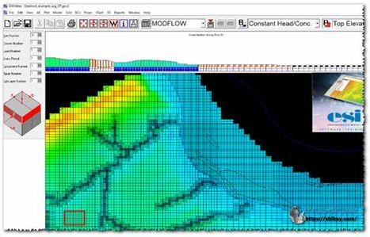
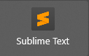
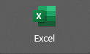
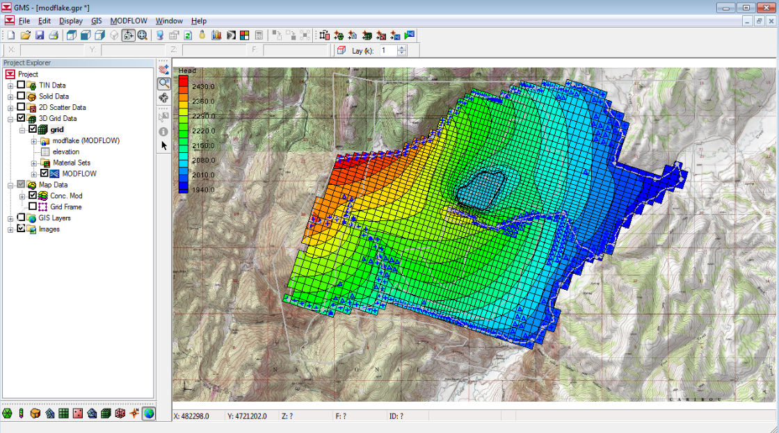
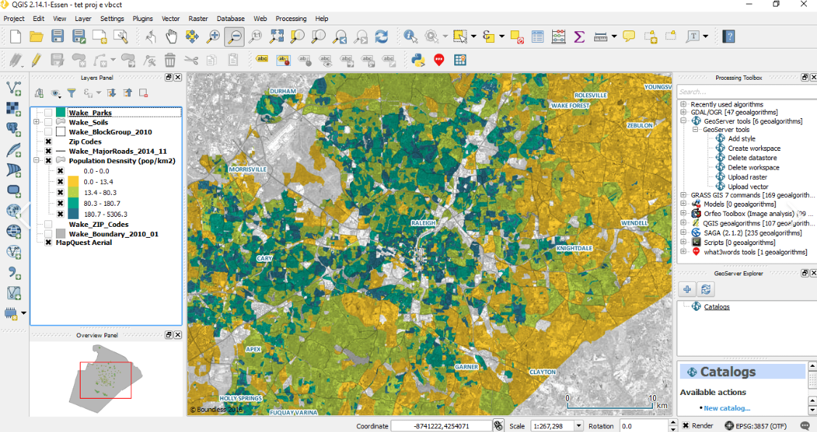
MODFLOW + Python = FLoPy model input
MODLOW doesn’t care how you create the text file, it just needs the values in a readable format

Slide 15
MODFLOW + Python = FLoPy model input
In FloPY, we create python “objects” to represent our model and packages, and use “pythonic representations of data” to populate the package properties
=
np.ones((21,9)) * 0.002208

Slide 16
MODFLOW + Python = FLoPy model input
In FloPY, we create python “objects” to represent our model and packages, and use “pythonic representations of data” to populate the package properties
tpl_dir = os.path.join("data", "mumodel_tpl")
name = "mumodel“
exe_name = "mf6“
sim = flopy.mf6.MFSimulation.load(sim_ws=tpl_dir)
m = sim.get_model(name)
rch = m.rch
rch.recharge.set_data({0: 0.002208})

Slide 17
MODFLOW + Python = FLoPy model input
CONS:
Difficult (at first!)
Opaque
PROS:
Fast (eventually!)
Flexible
Reproducible
Automatable
Free

Slide 18
MODFLOW + Python = FLoPy model input
DEMONSTRATION

